Slide 1
Milwaukee LiDAR

Slide 2
LiDAR
LiDAR, to not get too technical, is remote sensing method using lasers to measure distances, typically for land topography.
Creates highest resolution of topography, sometimes going to less than 1 foot, however, LiDAR mapping is incredibly resource intensive, so high res mapping not practical for incredibly large areas.

Slide 3
Intents
Learn to process LiDAR data.
See what potentials and shortcomings there are with such data.
I don’t really have a solid goal honestly.

Slide 4
Data
Data from Milwaukee county GIS. (https://data-mclio.hub.arcgis.com/apps/7a1d3d055d4b4457845c721088c132f0/explore)
Data Resolution: 5-15 cm.
Data on MKE airport only.

Slide 5
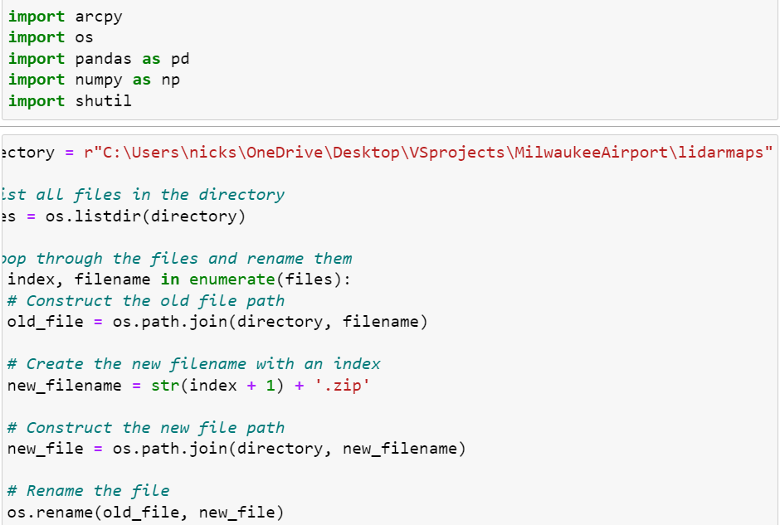
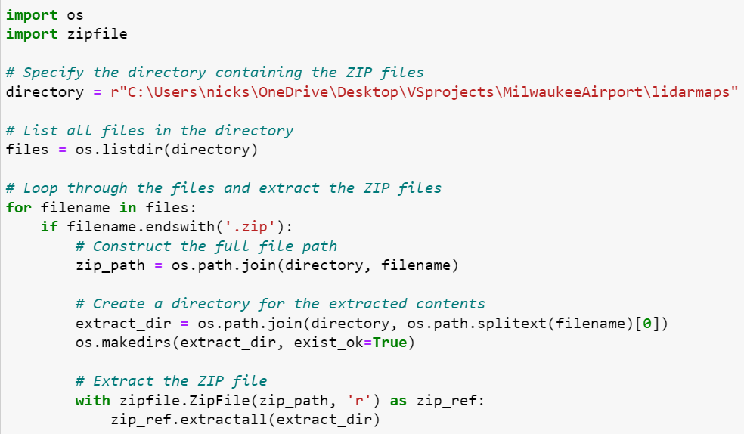
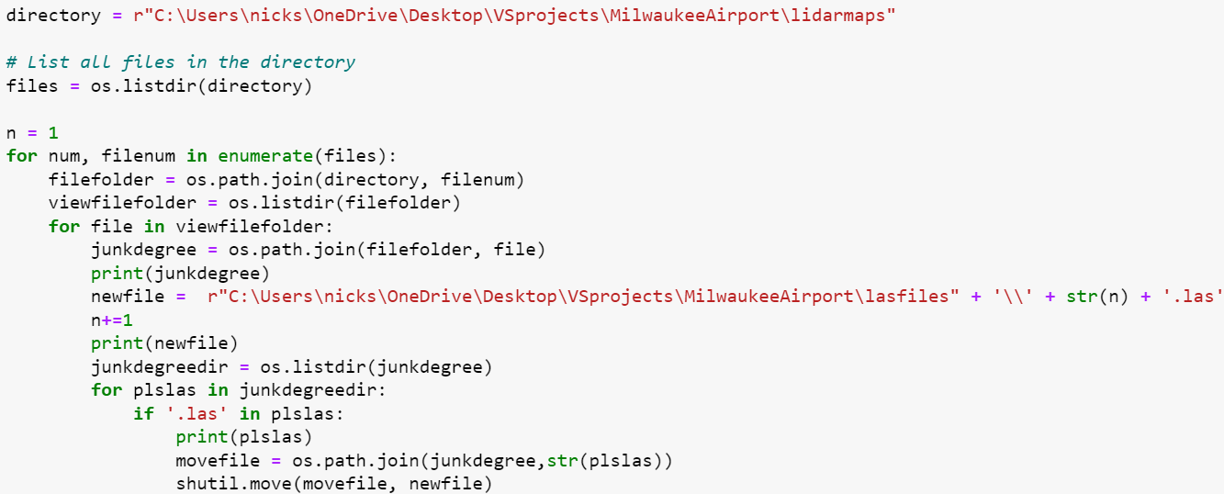
Data Gathering & Processing (Excessive Explanation)
Downloading data from site rather tedious since you have to click each square and click download.
Move files to project location.
Automate renaming python files, unzipping them, and moving .las files to desired folder so all can be loaded up at once in ArcGIS pro
Load in ArcGIS and then combine .las files into one.

Slide 6
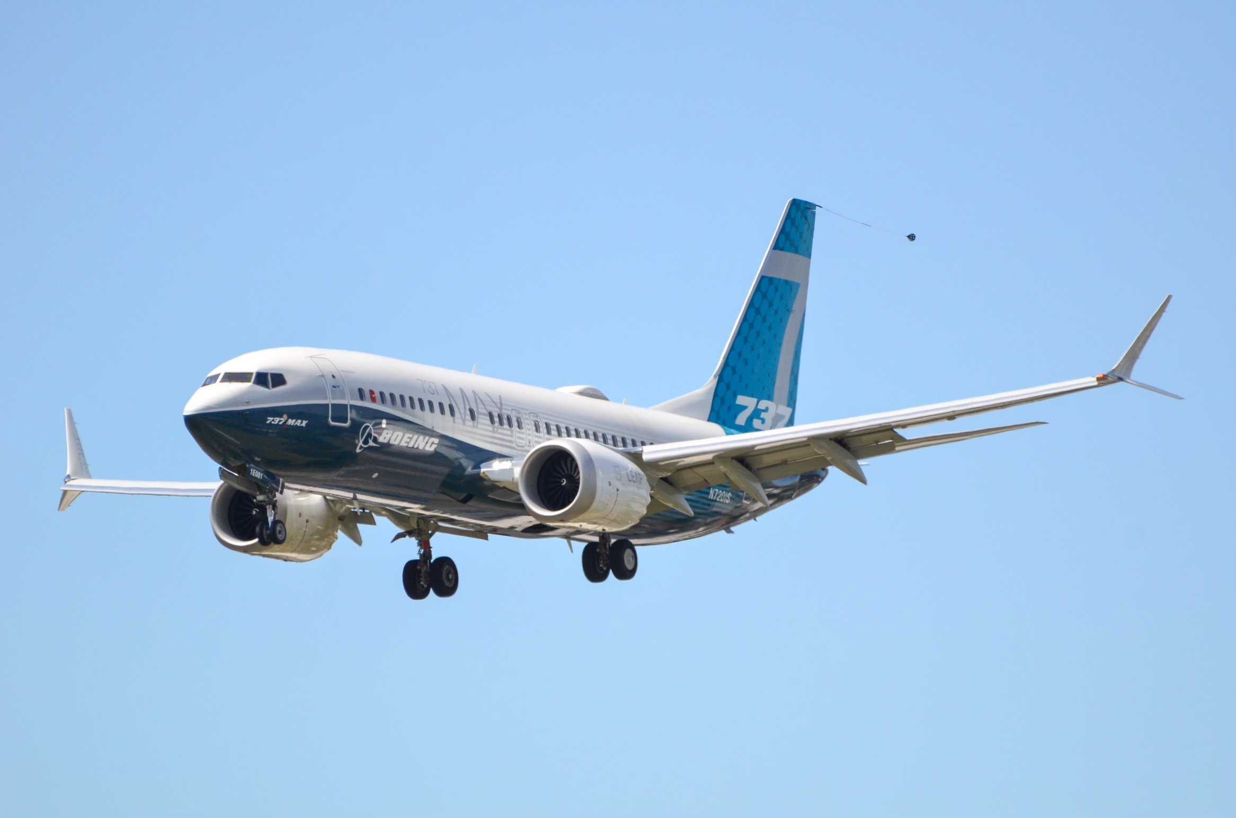
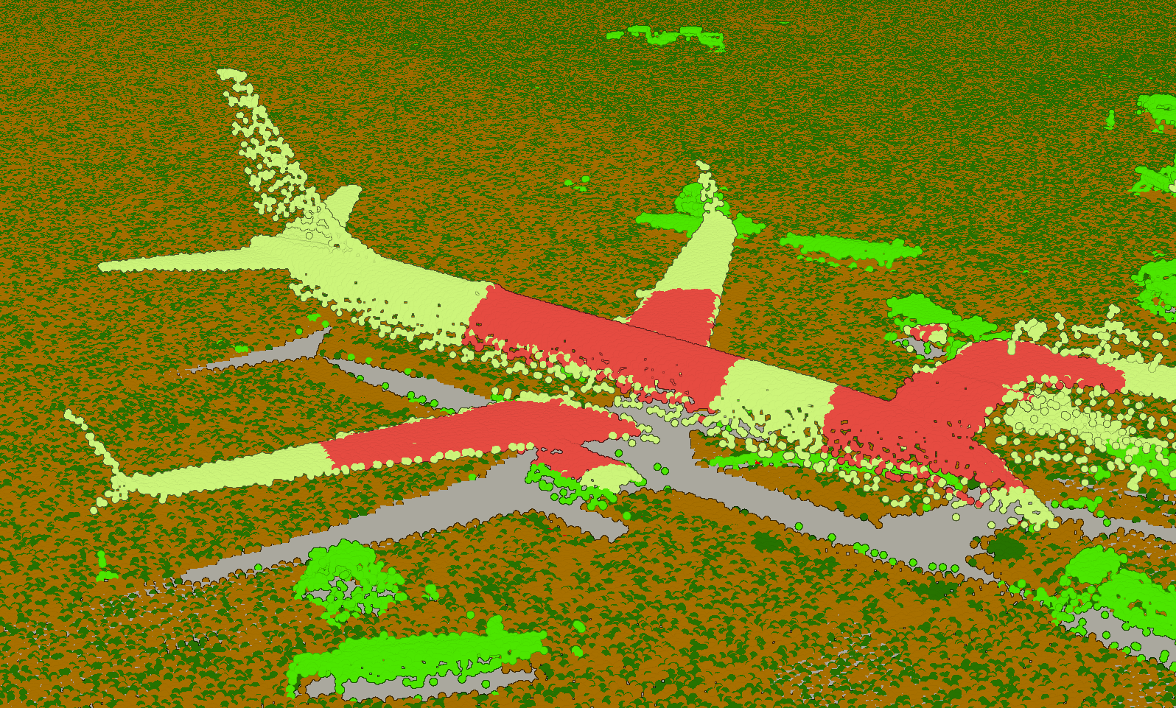
Analysis
Quite impressed with the amount of detail I can see
Image clearly shows it’s a 737 max.
Both winglets visible, something I didn’t expect would be detected since it’s relatively small and is under upper winglet. ‘Angling’ of LiDAR must have detected it.
Can identify airplane bodies well, but it would be like explaining facial features.

Slide 7
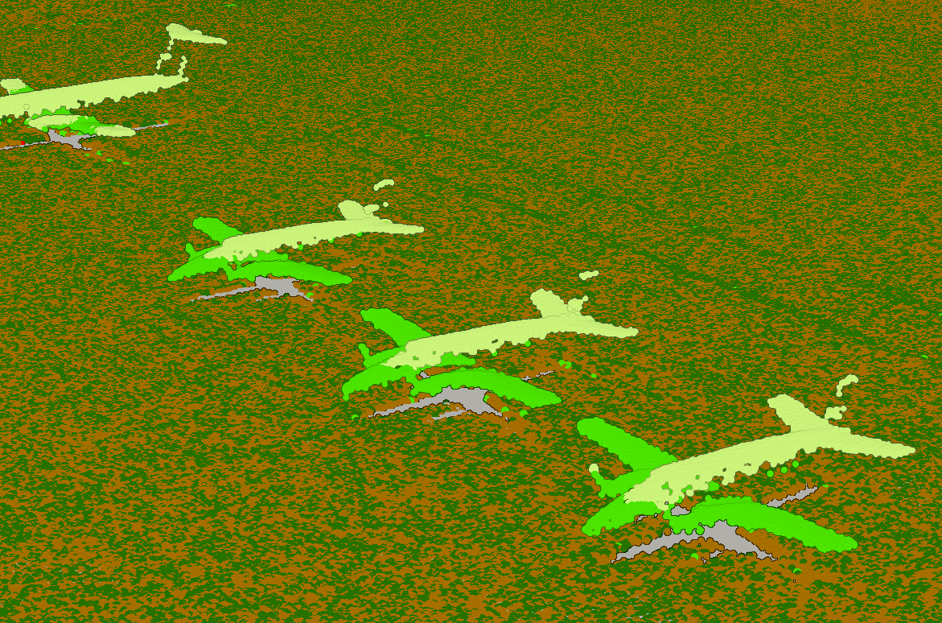
Analysis(Cont.)
Even smaller planes can be well detected and possibly distinguishable.

Slide 8
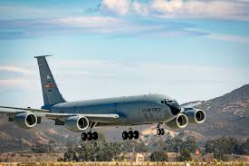
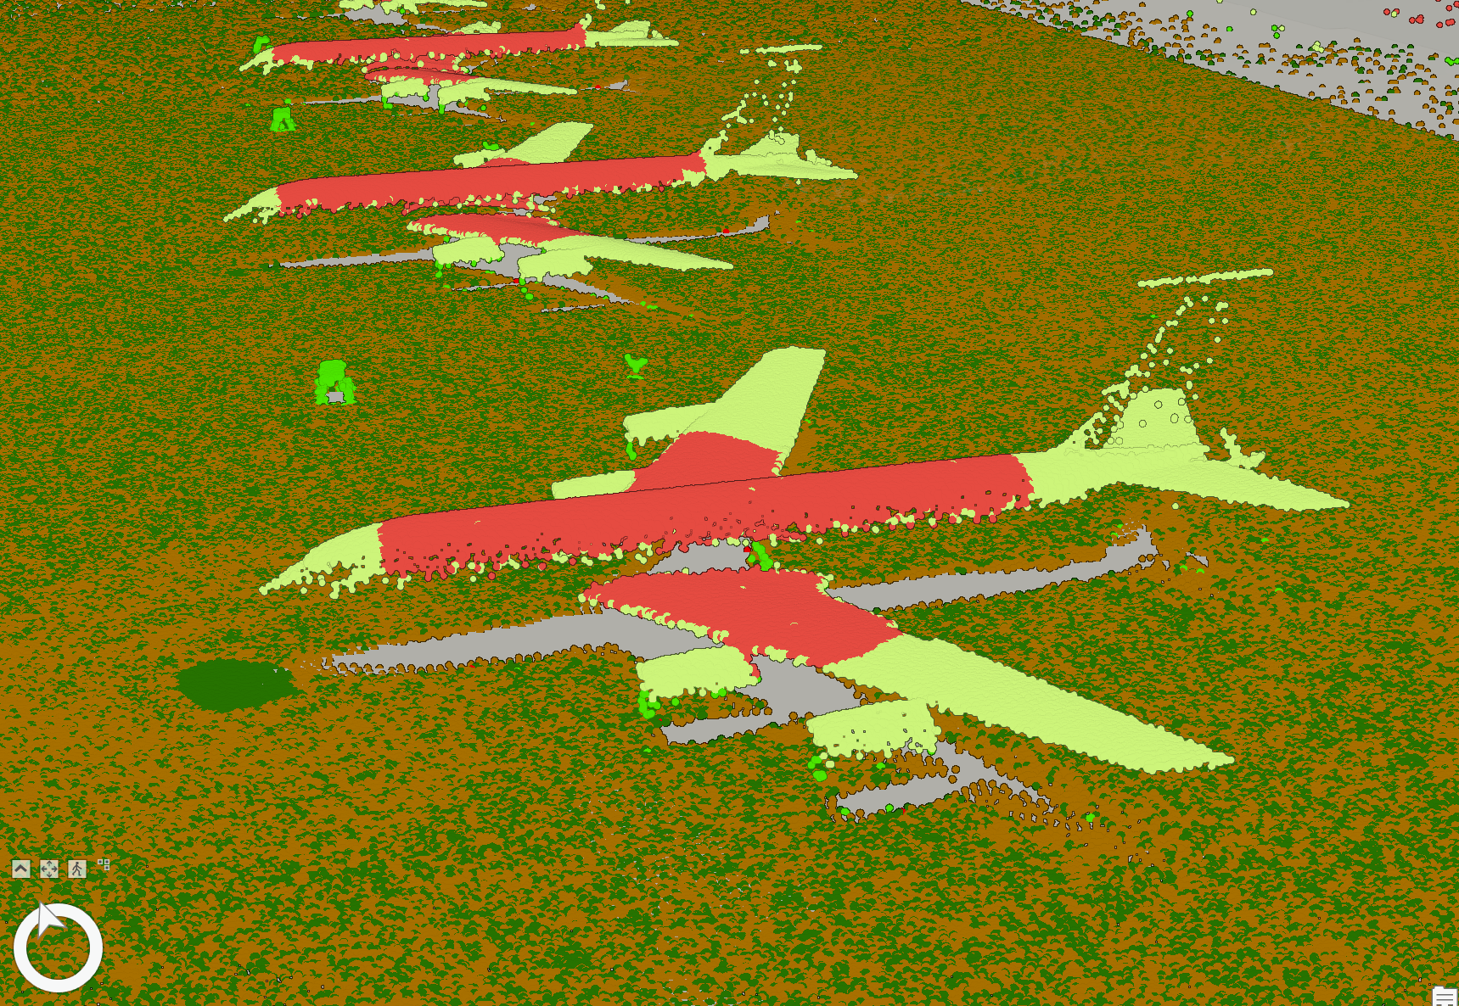
Analysis (Cont.)
Sensors can even detect HF Antennae on KC 135s.

Slide 9
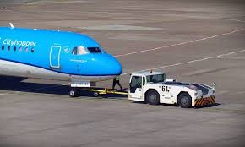
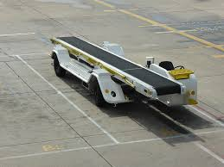
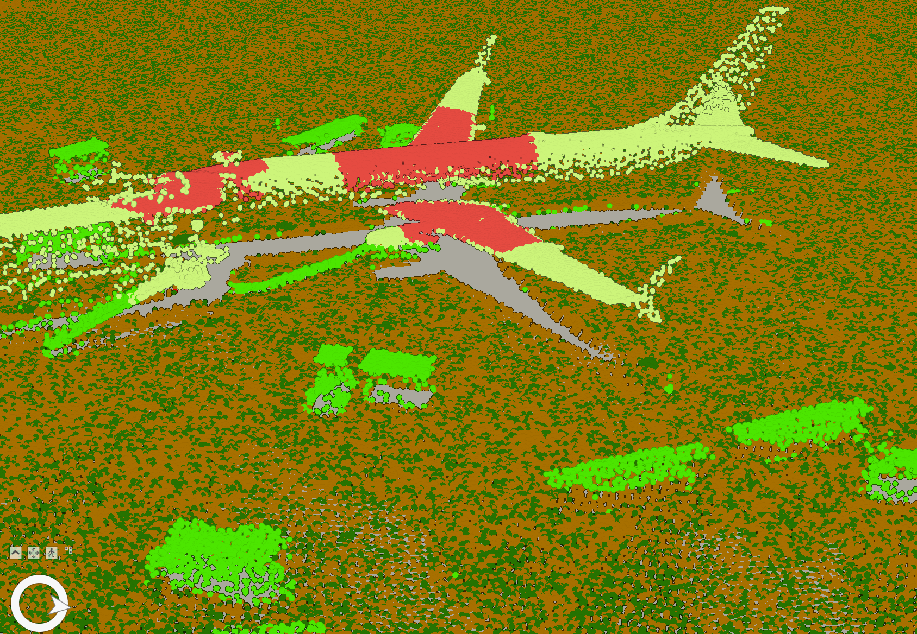
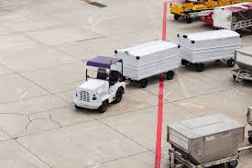
Analysis (Cont.)
Ground vehicles are also detectable. (Circles color coded)
Humans barely detectable, but I think I see them.

Slide 10
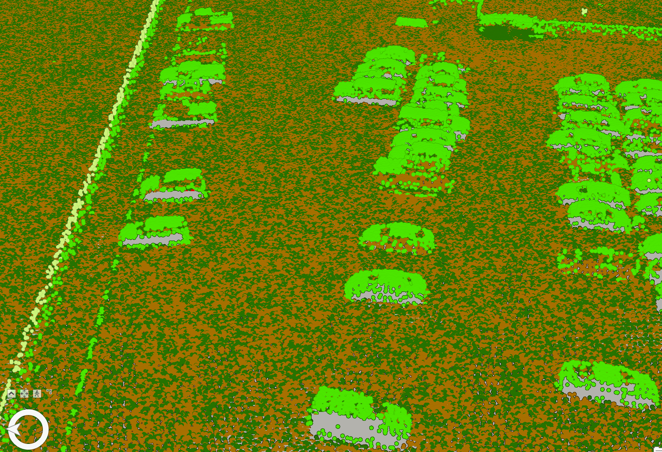
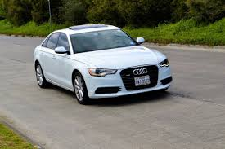
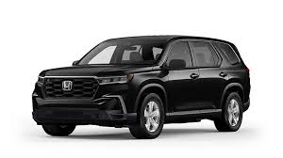
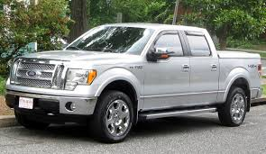
Analysis (Cont.)
Cars can be distinguished by general type. (Sedan, SUV, Van, Pickup truck)(Circles color coded again)

Slide 11
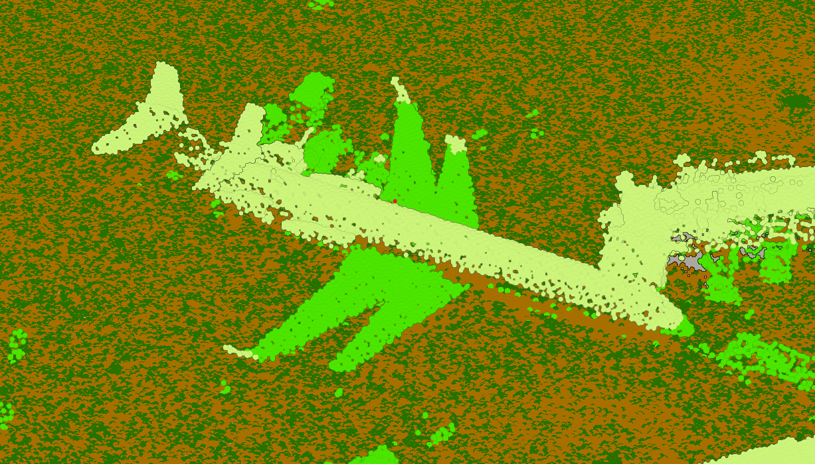
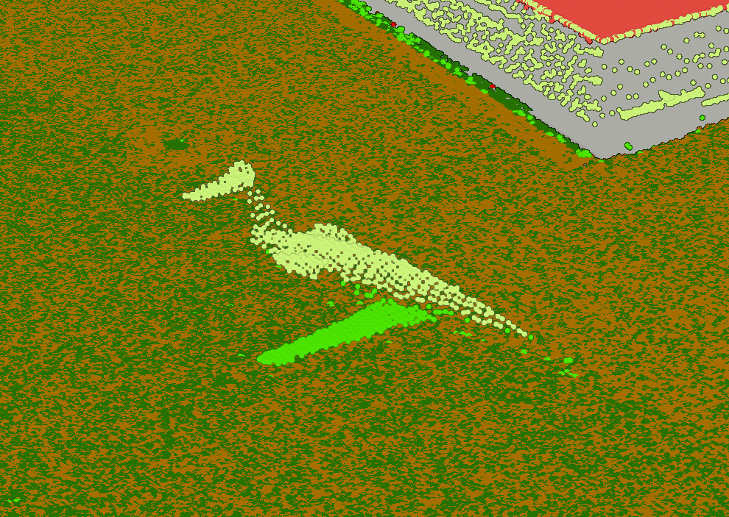
Analysis (Cont.)
It appears that the plane scans over the same area with lidar about twice as evidenced by this photo.
There are ‘2 planes’ which are each in a comprehensible shape, one time when it was still and another when it was taxiing.
Shows there’s limitations when it comes to objects that aren’t planted like buildings.
Half a plane is missing because scan only hit half of moving plane at time.

Slide 12
Further Takeaways
The amount of details shown of the planes shows potential for using ML to identify them.
Biggest limitation is a *lot* more data (There’s very few available data at this good of resolution) will be needed to create a network.
Actual distance can be determined in data, so Neural Network *might* be capable of using those features to more effectively learn different types of planes.
Windows are not detected, evidenced by clear frames in cars.
Laser doesn’t bouce back as well on windows for detection.

Slide 13
Making 3D map
Want to map out the important buildings of the airport area and also the planes.
Change classification of LiDAR points with lasso tool.
Diverge further steps for building and planes.

Slide 14
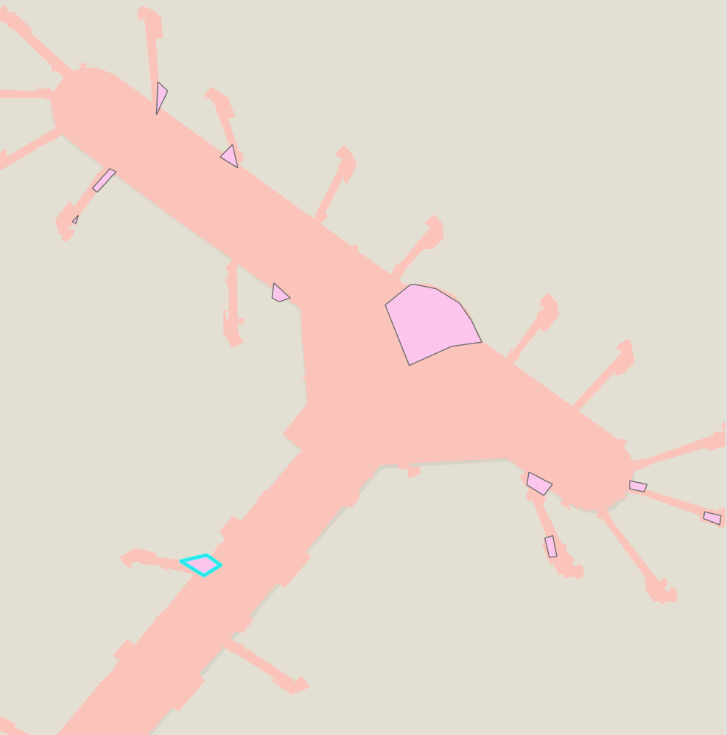
Making 3D Map (Cont.)
Get LAS point statistics as raster.
Convert the raster to polygon.
Delete irrelevant polygons.
Regularize polygons.
Fill in gaps of polygons with another polygon then merge. (See image)
Dissolve merged polygon.
Filter LAS points to only ones within polygons. (There’s way too many points that processing fails in later steps)

Slide 15
Making 3D map (Cont.)
Extract DEM of clipped LAS points.
Use LAS build ing multipatch tool using clipped LAS.

Slide 16
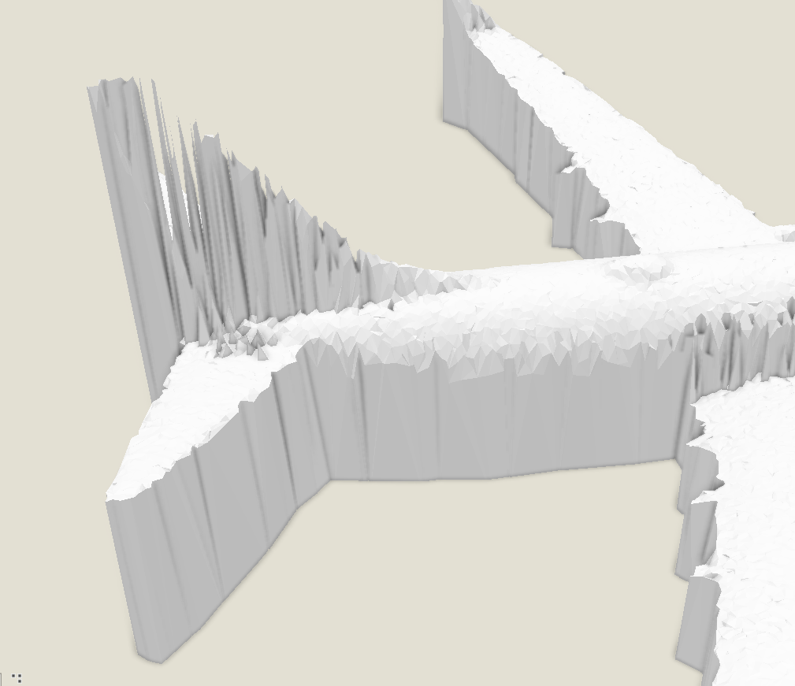
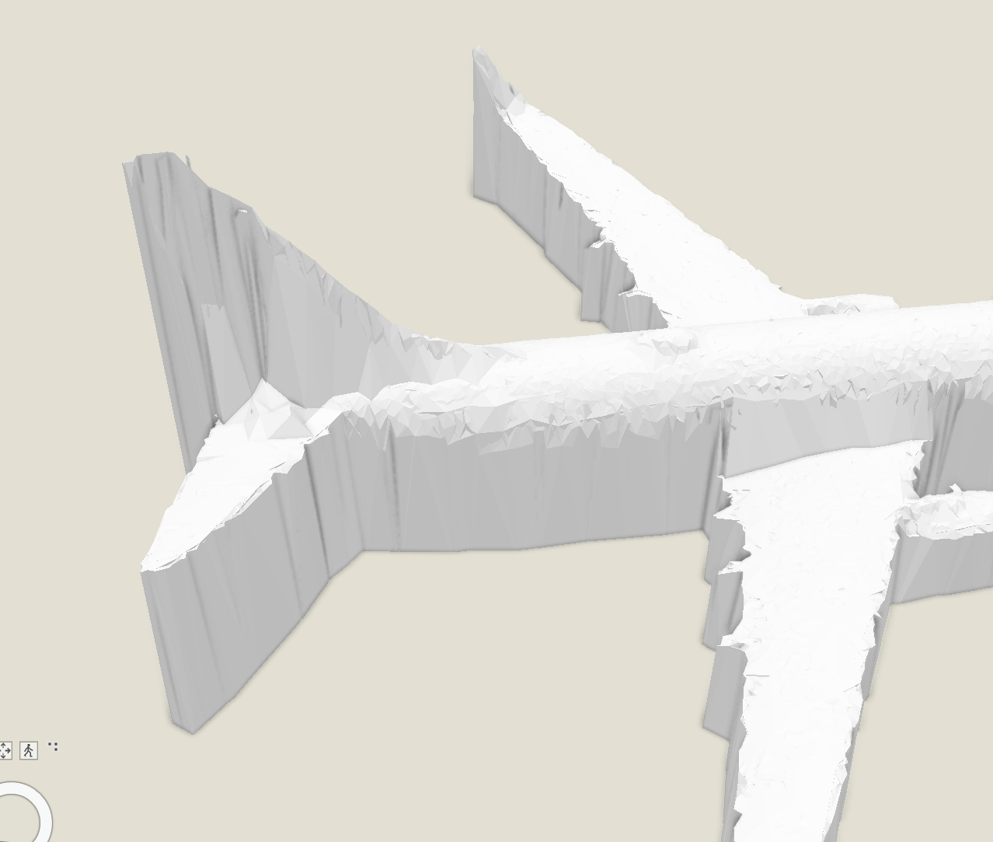
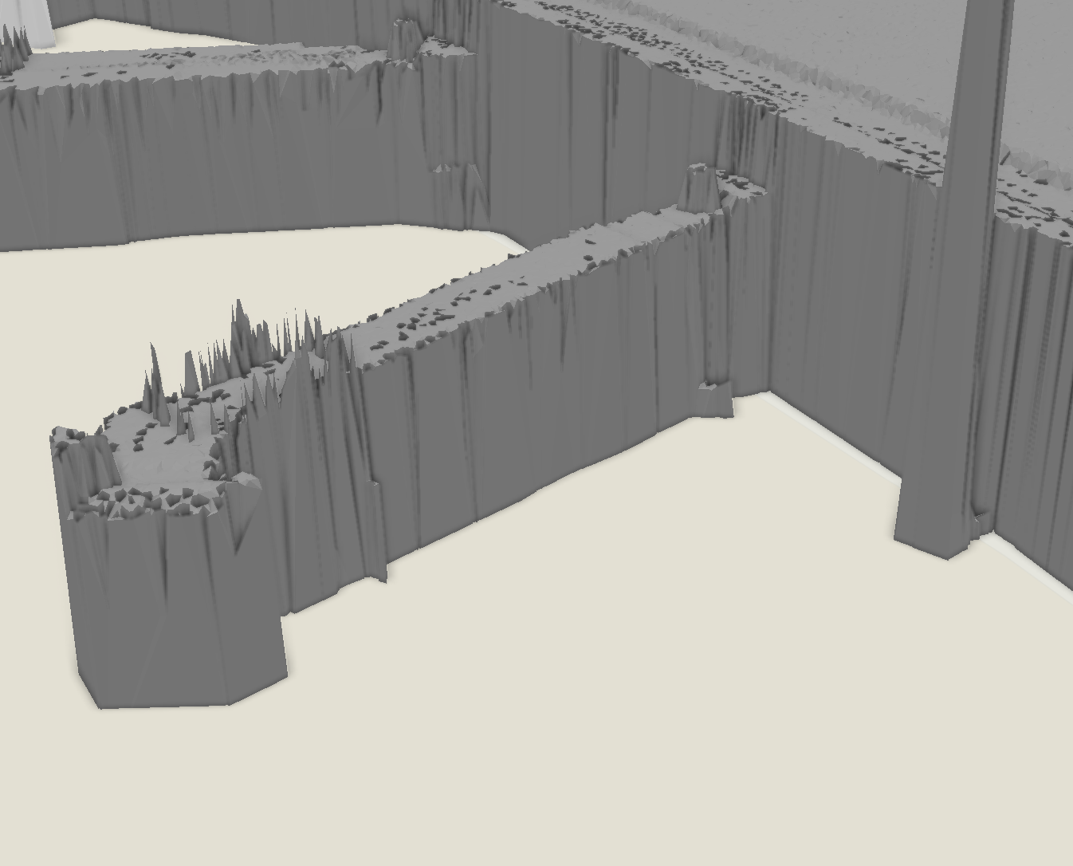
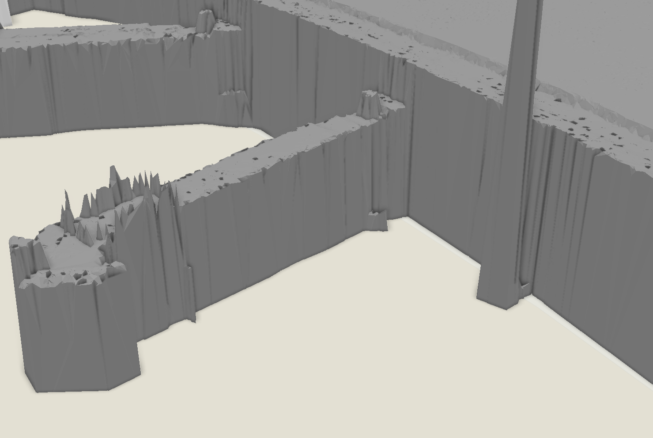
Making 3D map (Cont.)
3d models end up looking extremely jagged in some spots.
Create another 3d model with .25 meter tolerance and display it with 0 tolerance model to fill in gaps, while maintaining most of details.

Slide 17
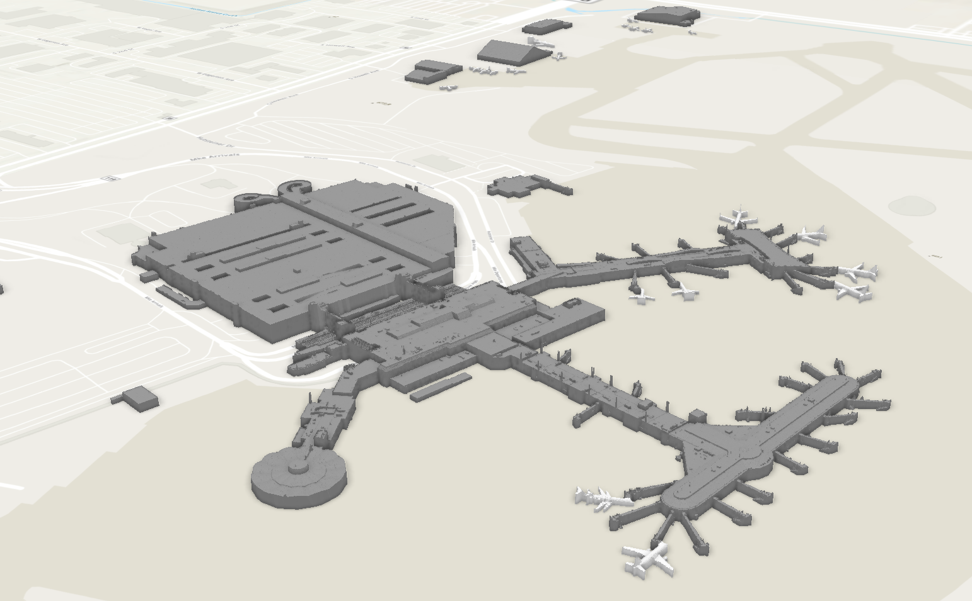
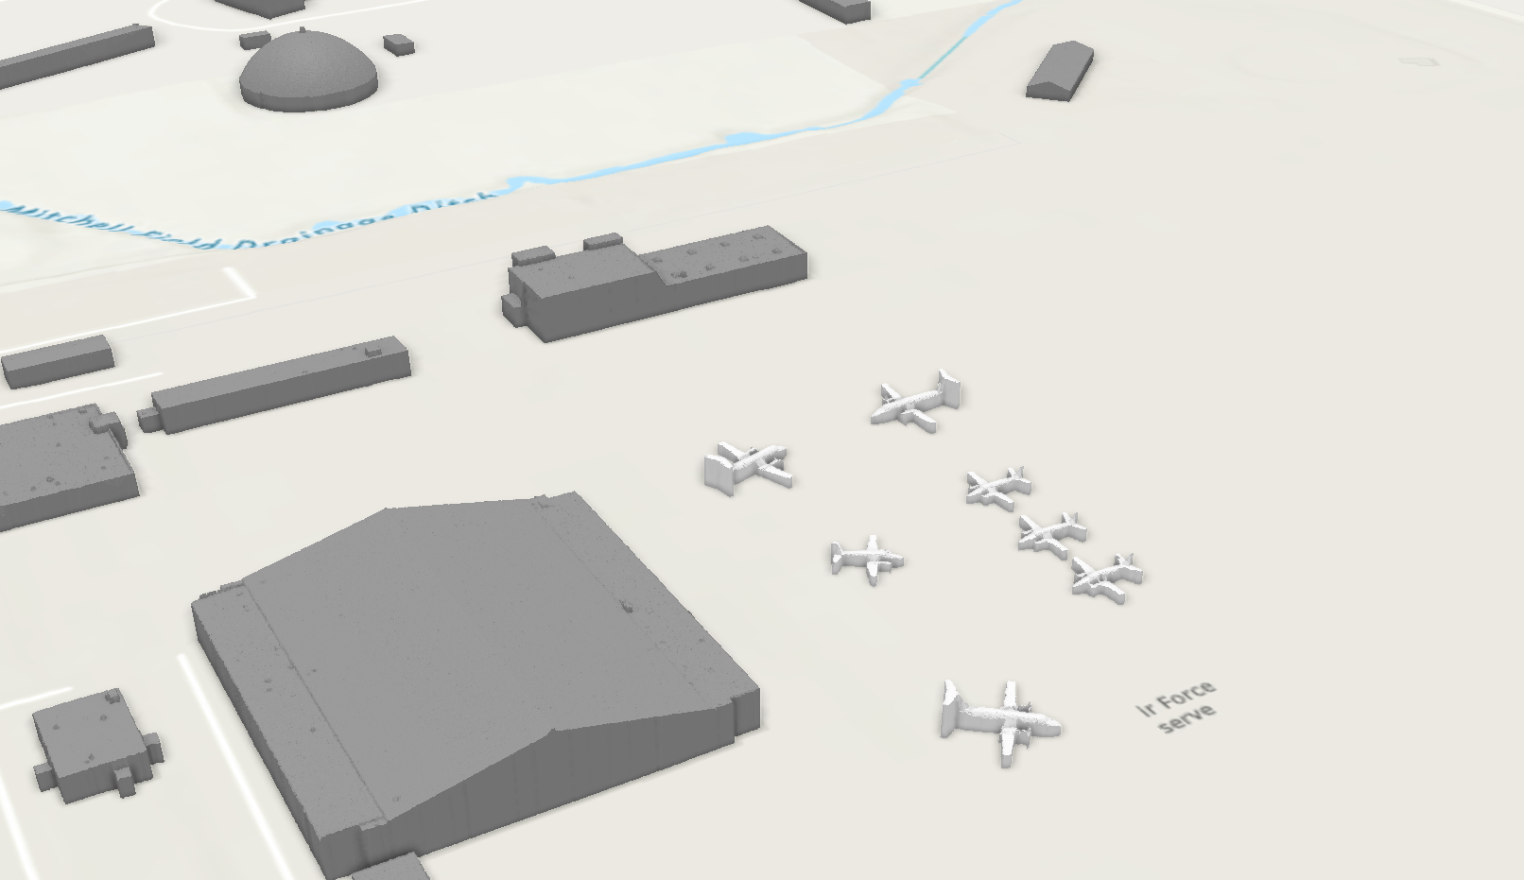
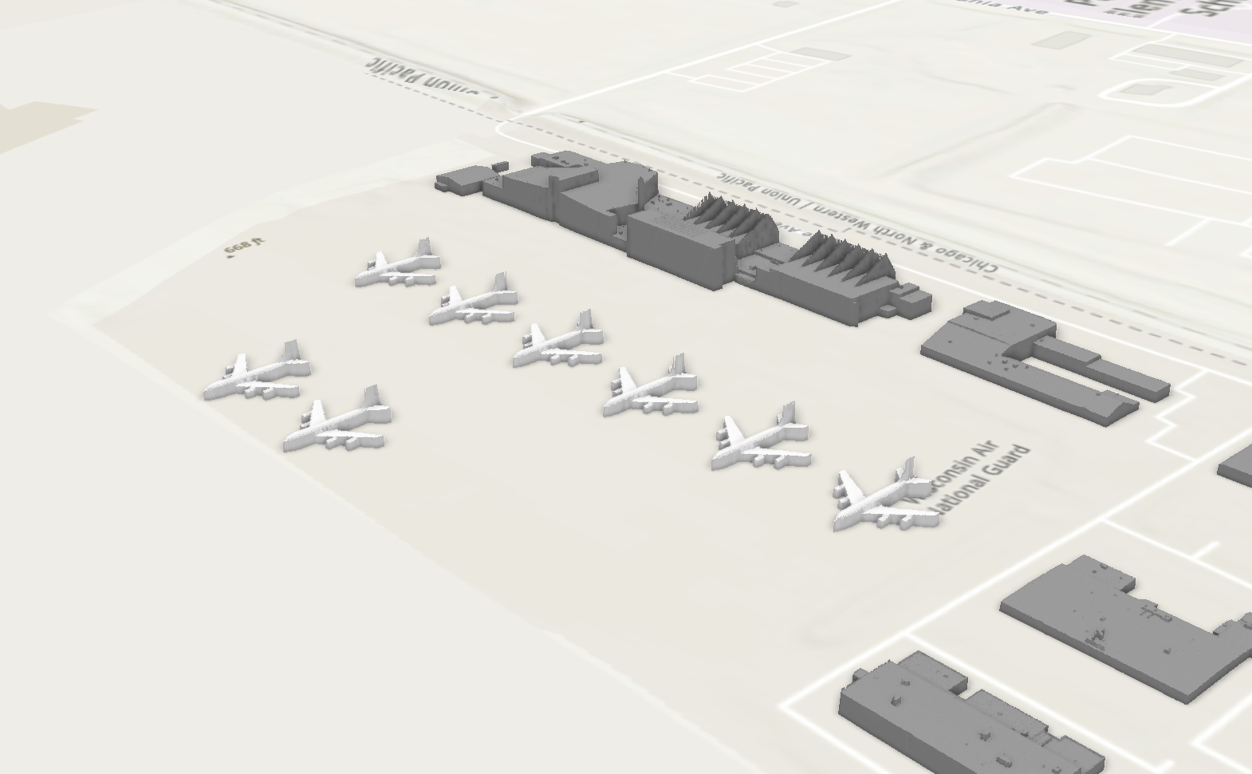
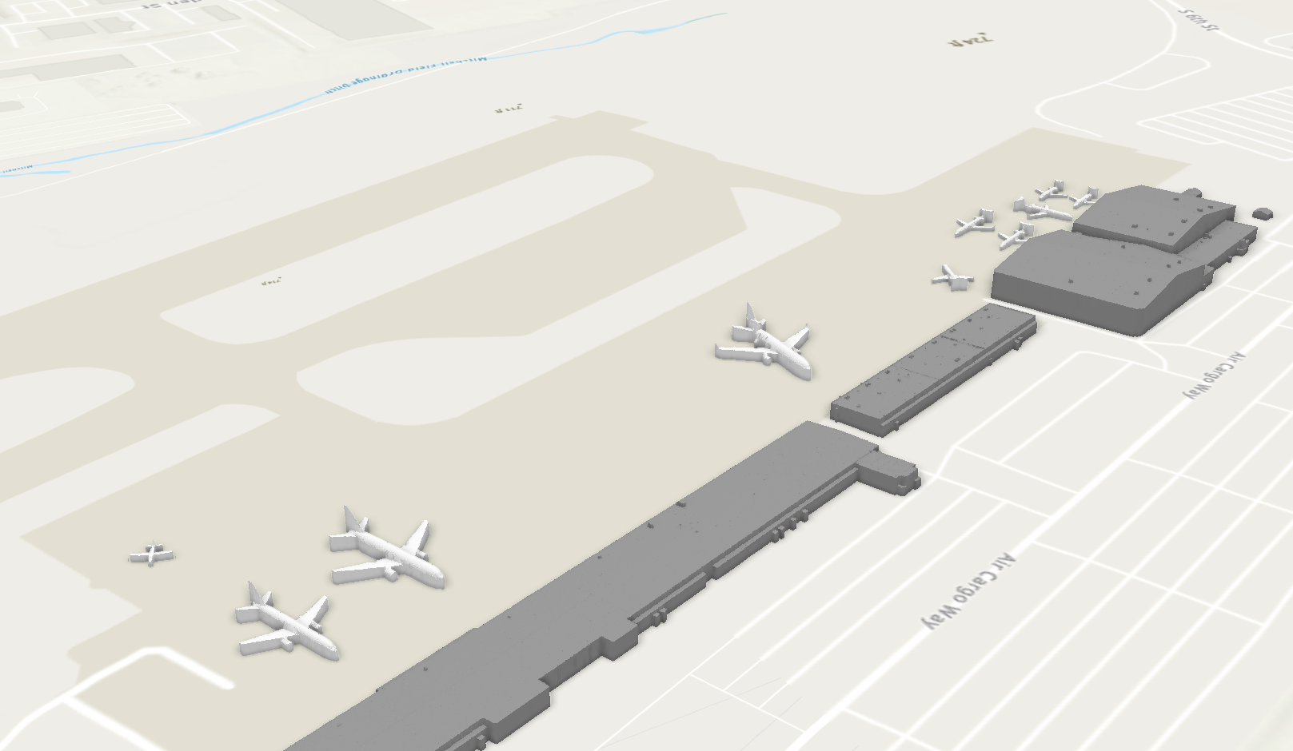
Result

Slide 18
Takeaways
Creating 3d models is insanely computer intensive, even my computer with high end specs was pushed to the max.
Planes are a bit harder to represent compared to buildings in 3d models since there’s empty gaps and more complex structures on the underside which lidar simply cannot capture.
Lidar data is insanely huge, the raw data was 16 GB.
I could try figuring out how to filter out irrelevant data (Time, Intensity, etc.) in each point to streamline in the future since I noticed there was a lot of irrelevant details in each point.

